Slide 1
Leveraging Kafka
Iqbal Khan
Notes:
Template version: 7/29/2013, for PowerPoint 2010

Slide 2

Established 1999, it is a charitable organization
The mission of the Apache Software Foundation (ASF) is to provide software for the public good
Currently 350+ open source initiatives at the ASF – HTTP Server, OpenMeetings etc
Apache License 2.0 – January 2004
Permissive free software license
One project under this license is Apache Kafka
Notes:
The messages are not pushed to the consumer, instead, whenever the consumer is ready it pulls data from the queue.

Slide 3
Kafka History
Created at Linkedin and open sourced in 2011
Jay Kreps, Neha Narkhede and Jun Rao worked on Kafka at LinkedIn
Kreps named it after famous author Franz Kafka - "a system optimized for writing"
Notes:
The messages are not pushed to the consumer, instead, whenever the consumer is ready it pulls data from the queue.

Slide 4
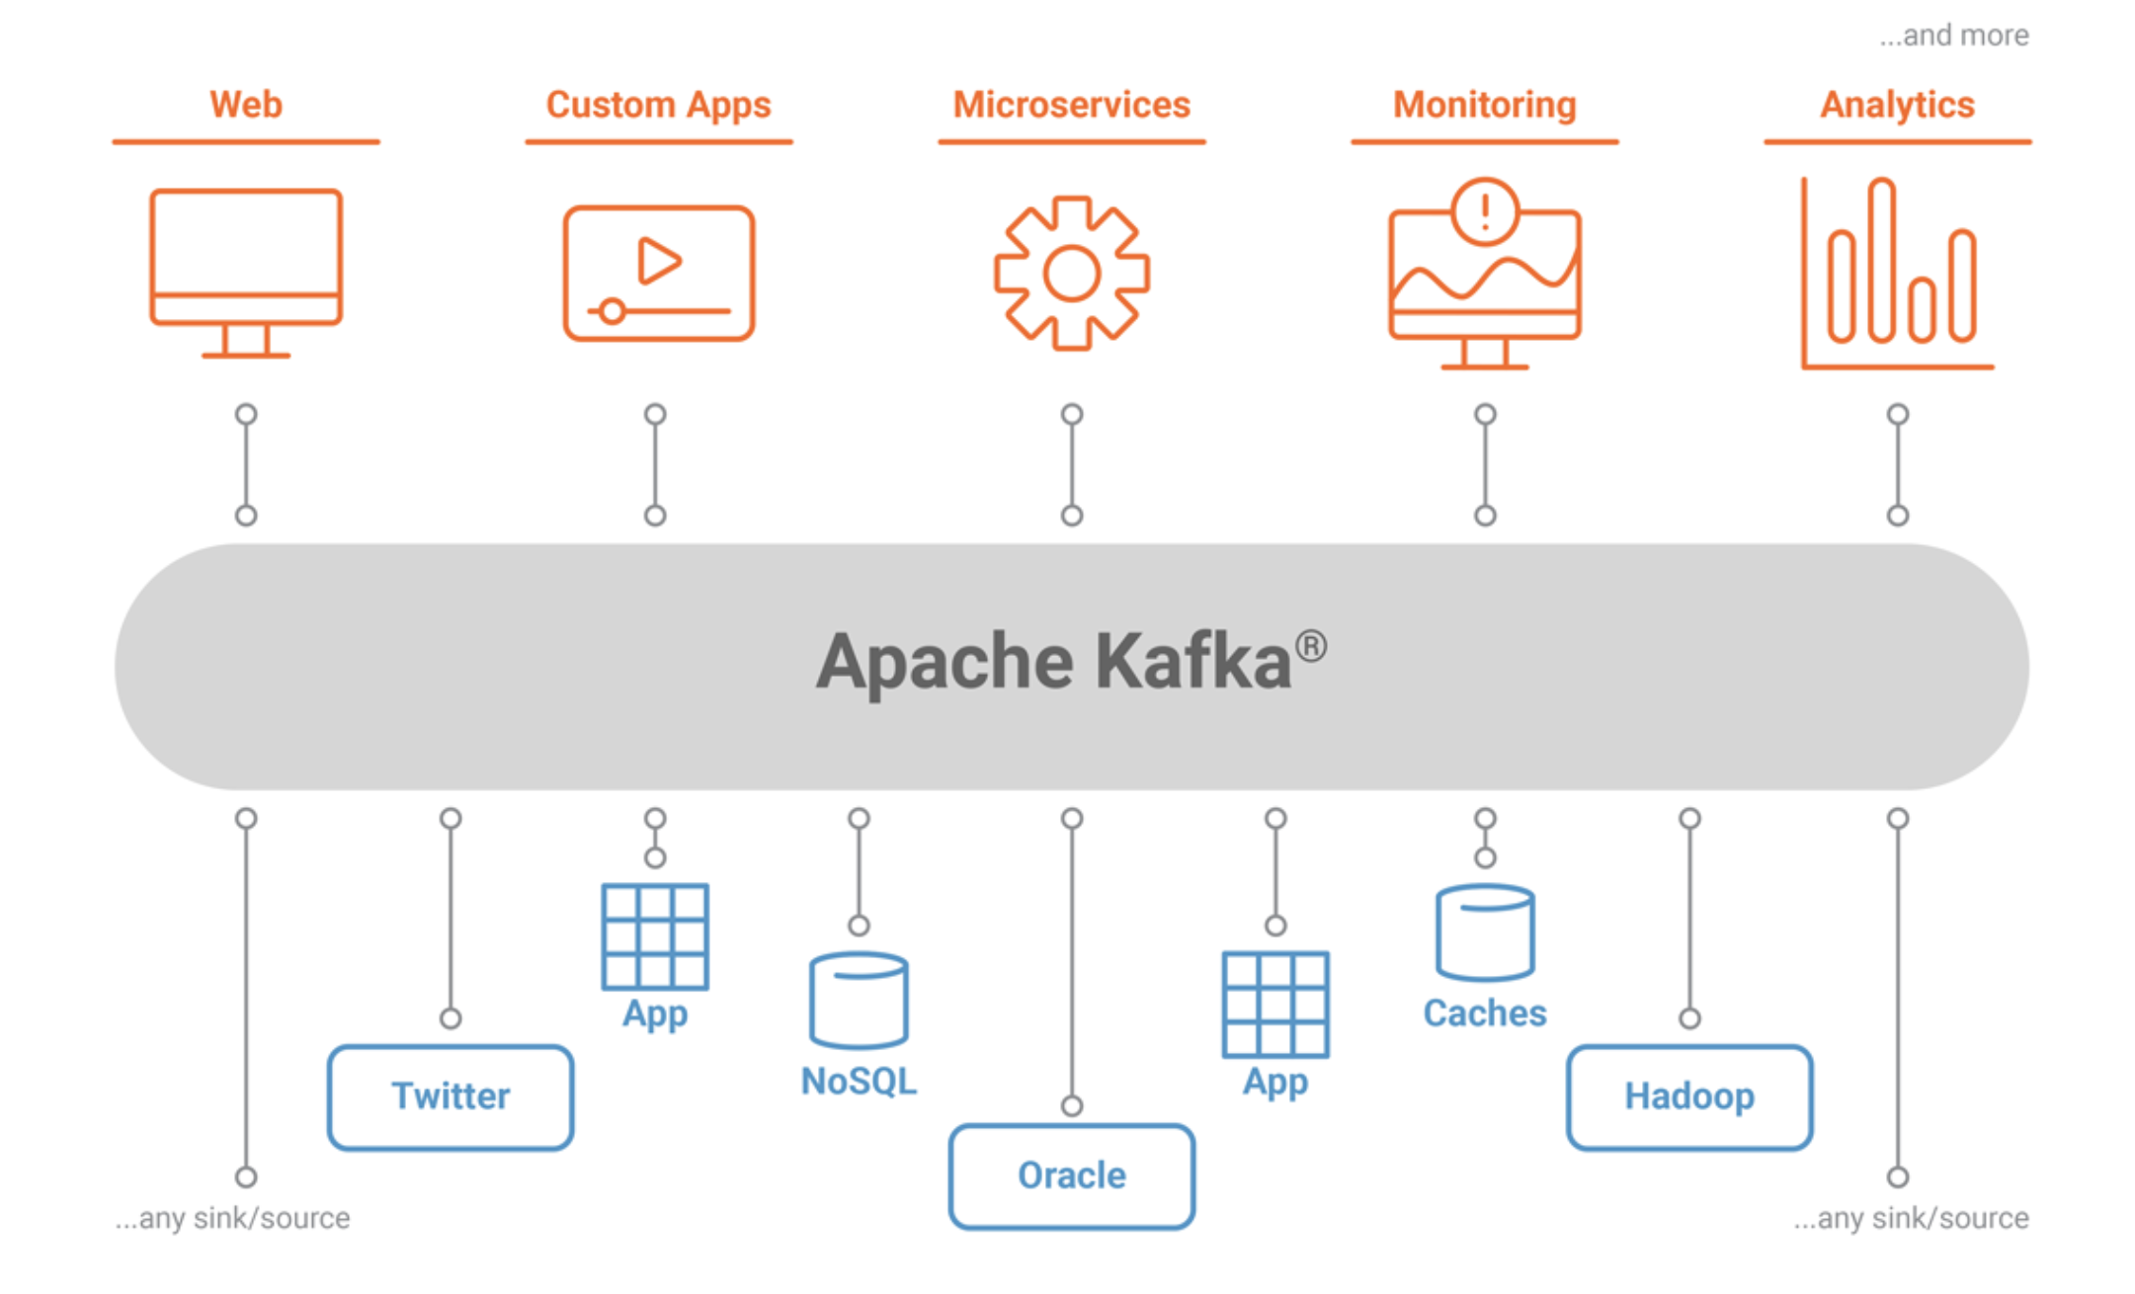
Notes:
The messages are not pushed to the consumer, instead, whenever the consumer is ready it pulls data from the queue.

Slide 5
Distributed: Multi node system; provides Resiliency and redundancy
Horizontal Scaling: addition of more machines or setting up a cluster or a distributed environment for your software system – scale out.
You’d need a coordinator to handle this architecture
Something to help with managing the distributed system
Publish and subscribe to streams of records
Store streams in a fault-tolerant durable way
Process streams of records as they occur
Notes:
The messages are not pushed to the consumer, instead, whenever the consumer is ready it pulls data from the queue.

Slide 6
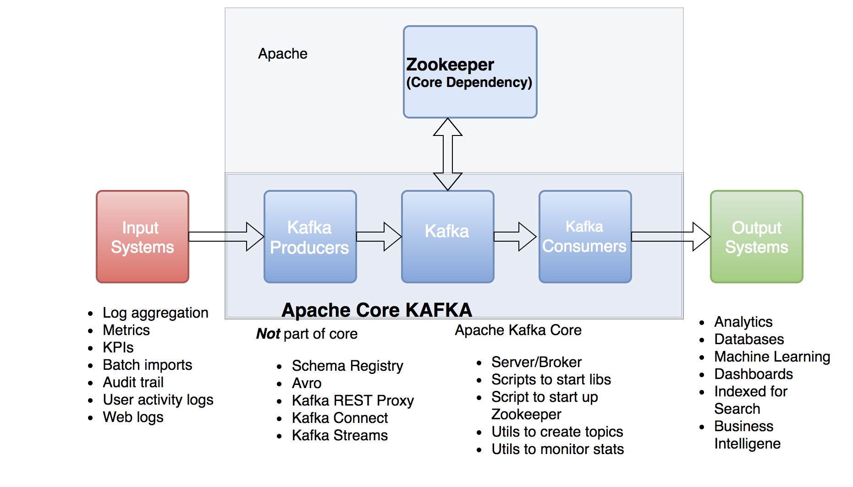
Kafka: A Deeper Look

Slide 7
Centralized service that maintains configuration data and synchronization
Handles metadata:
Controller Election: Leader follower relationships for replication
Configuration of Topics: List of existing topics, partitions per topic, location of replicas etc
ACL: Access lists for topics and brokers
Cluster Health and Membership: Check status

Slide 8
Node in a Kafka Cluster
A node receives messages from producers and stores them on disk keyed by unique offset. Offset is nothing but a sequential ID that is assigned to a record.
A Kafka node allows consumers to fetch messages by topic (and other parameters).
Nodes can create a Kafka cluster by sharing information between each other directly or indirectly using Zookeeper. You need to have zookeeper running before starting kafka.
Each cluster has 1 node that acts as “controller” which is responsible for managing the states of partitions and replicas and for performing administrative tasks like reassigning partitions.

Slide 9
Nodes And Partitions
Kafka will replicate your data across nodes – replication factor configuration
Each node holds a number of partitions and each of these partitions can be either
a leader or a replica for a topic
All writes and reads to a topic go through the leader and the leader coordinates updating
replicas with new data. If a leader fails, a follower takes over as the new leader.
Leaders store primary copy of the data and distribute secondary copies through partitioning
Data redundancy to reduce latency and failure

Slide 10
How partitioning works
Partitions data based on partition keys for each record – id assigned to each incoming record
Partition API uses the key and number of available node partitions to return a partition ID.
Partition ID is used as an index into a sorted list of node ids and partitions to pick a node.
The default partitioning strategy is hash(key)%number_of_partitions
If the key is null, a random node partition is picked.
You can use a custom partitioning strategy if needed.

Slide 11
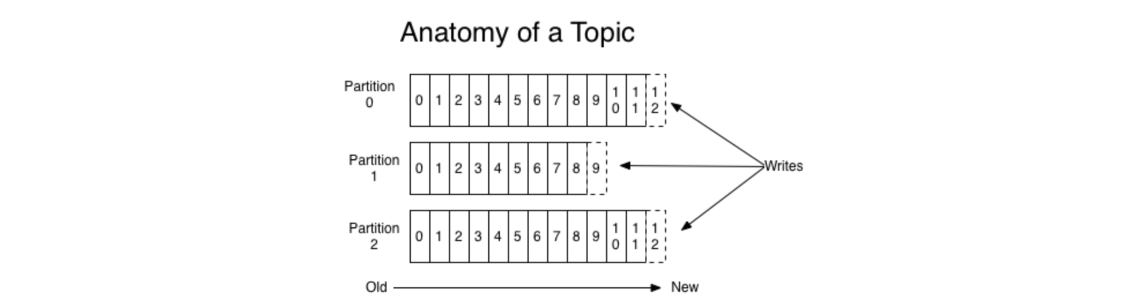
Partition and Topics
Topic is a category or feed name to which records are published.
Topics are multi-subscriber.
Retention time for a topic is 24 hours by default
Partitioned logs for topics look like this:
Writes to multiple partitions allow for parallelized reading by consumers

Slide 12
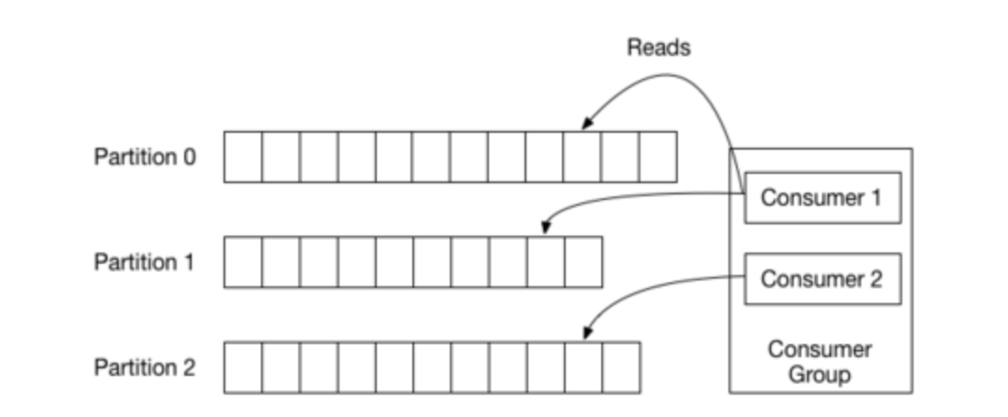
Consumer
1 group = 1 topic
Consumers can read a partition from any offset
If a consumer goes down and comes back up, it can read from last offset

Slide 13
Demo
Twitter as producer
Python program as consumer
We’ll subscribe to my favorite soccer team Manchester United!
NLP using TextBlob library and Pandas
TextBlob is a library for processing textual data
Uses NaiveBayes Algorithm and Stanford NLTK

Slide 14
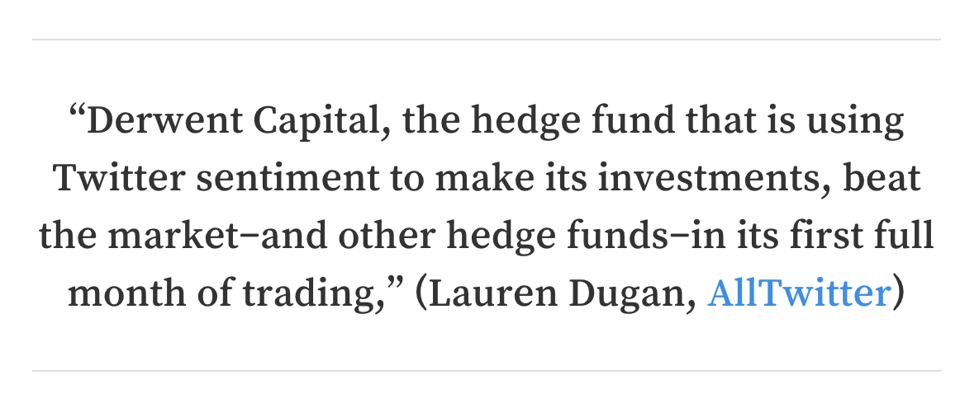

Why Twitter?
Rich source of streaming data

Slide 15
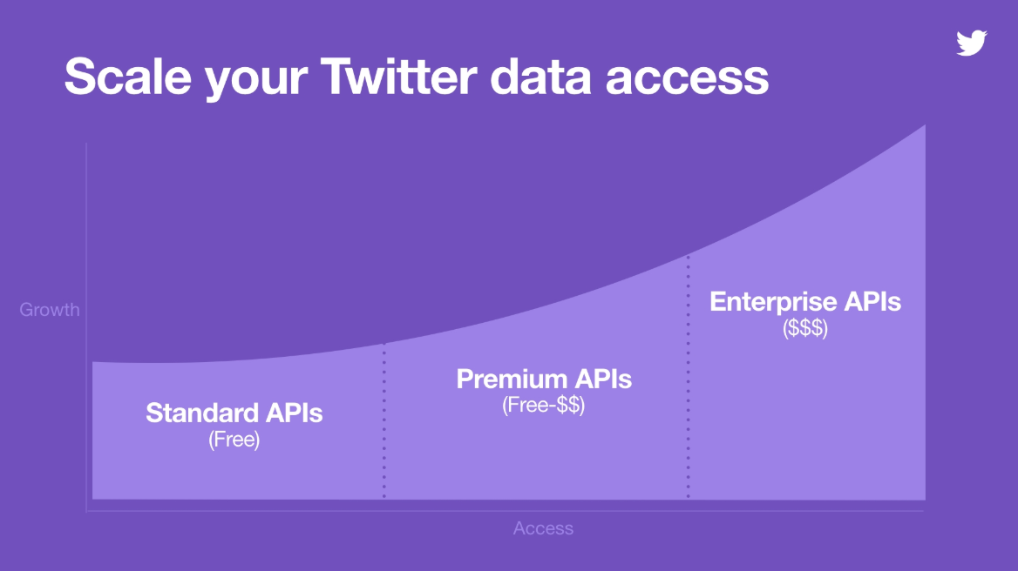
APIs

Slide 16
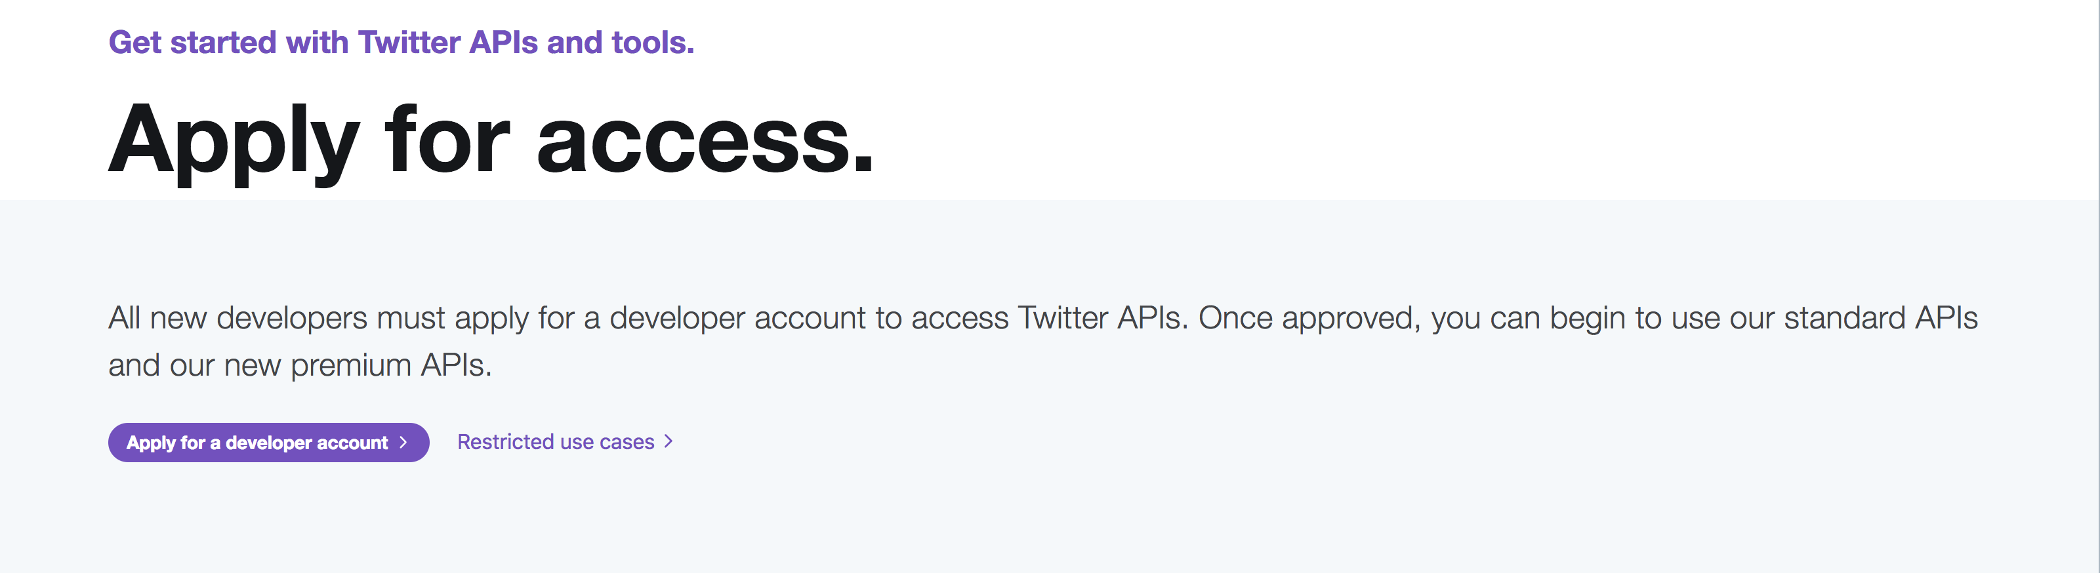
https://developer.twitter.com/en/apply-for-access

Slide 17
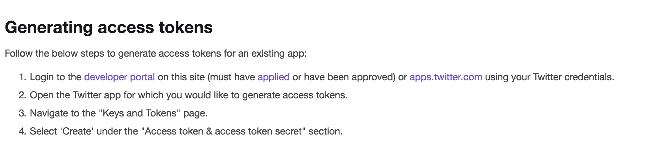
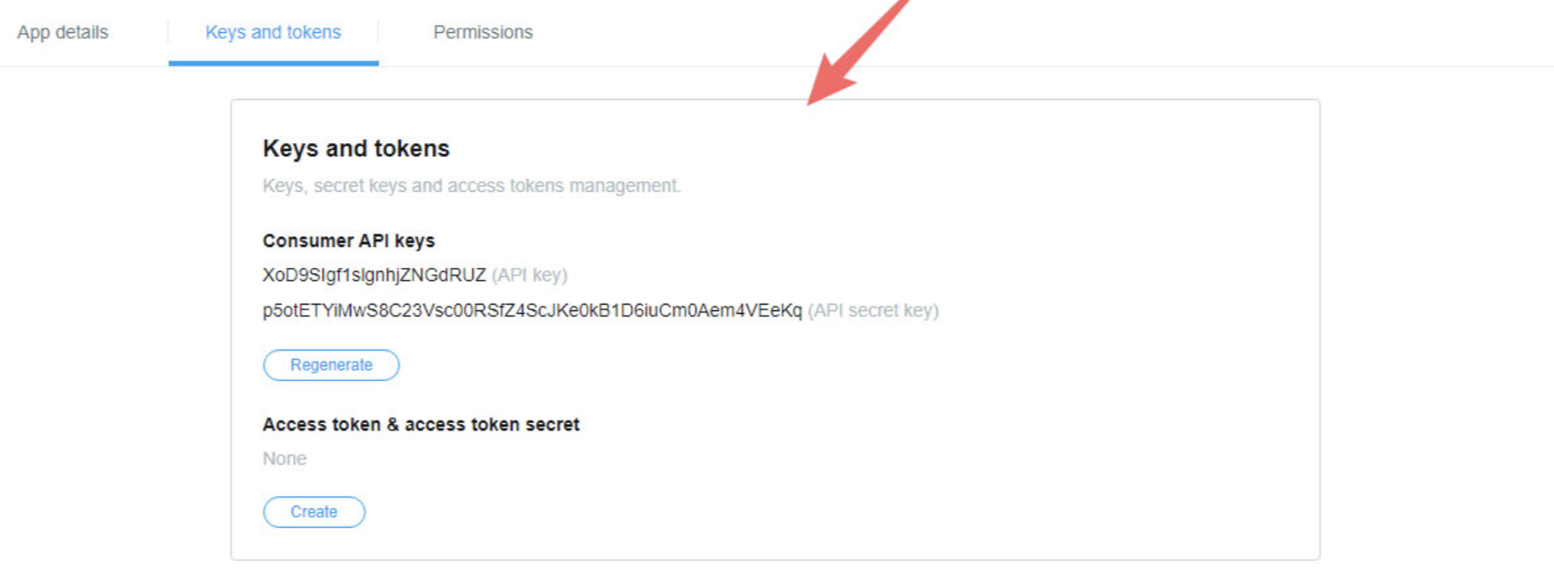

Slide 18

Overall Architecture
Twitter Feed
Apache Kafka and kafka
python library
Python consumer package
Text blob for analysis

Slide 19
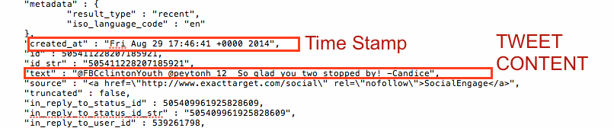
Sample Twitter Data

Slide 20
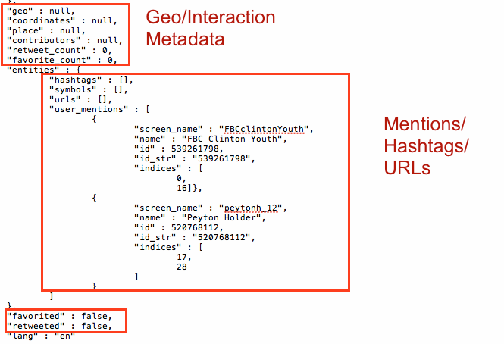

Slide 21
Installation
Install Homebrew: https://brew.sh/
Install java: brew cask install java
Install Kafka: brew install kafka
Start Zookeeper: brew services start zookeeper
Start Kafka: brew services start kafka
Follow instructions here: https://dzone.com/articles/running-apache-kafka-on-windows-os
Or use Docker container

Slide 22
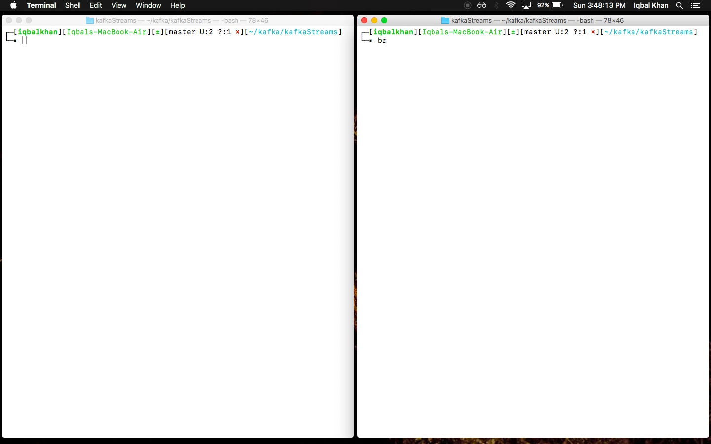
Demo

Slide 23
What about simpler SQL queries?
What if my use case is simpler? Example mundane SQL queries?
How would you “query” Kafka streams?
Store streams in a resilient DB? What’s the point of streams then?
Let’s say I don’t mind storing streams:
How would you know there is new data?
Batch jobs? How often?
Ideal scenario: Real time querying

Slide 24
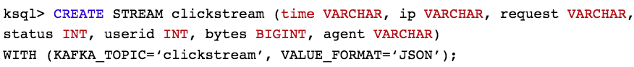
KSQL
Example:
Stream of user data being updated for each click(ex. User info)
Writing stream to a Kafka Topic example “clickstream”
We’re querying on JSON data
We’ve named the topic in stream definition (clickstream)
We’ve also defined the stream schema
You can run a select statement that’ll be updated in real time: SELECT * FROM clickstream;
The select is a “streaming query” – as long as there is a stream, there’ll be more results

Slide 25
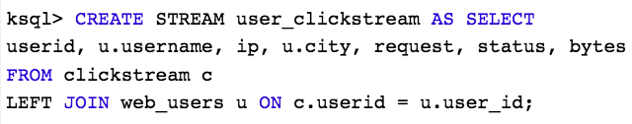
KSQL Select
Sample data output for SELECT statement:
Joining with Actual usernames: Say our table with usernames is dumped into a Kafka topic.
KSQL allows us to interpret Kafka topics as tables.
Think of messages in a topic as updates to rows in a table.
Joining to display usernames instead of user ids.

Slide 26
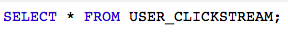
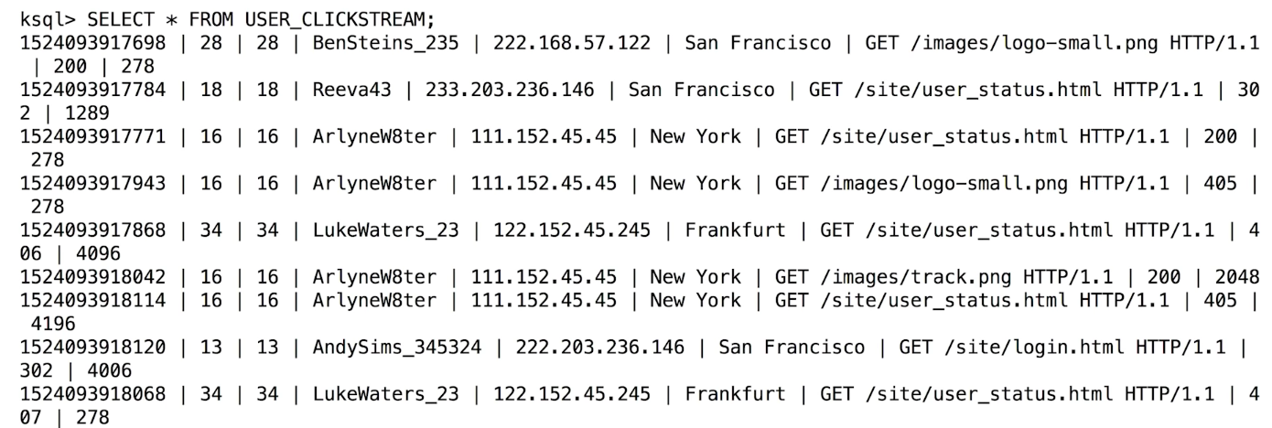
KSQL Joins
Joined on user table to display user names. This will also be a continuous stream
This stream can then be written to a Kafka topic and any consumer can subscribe to it

Slide 27
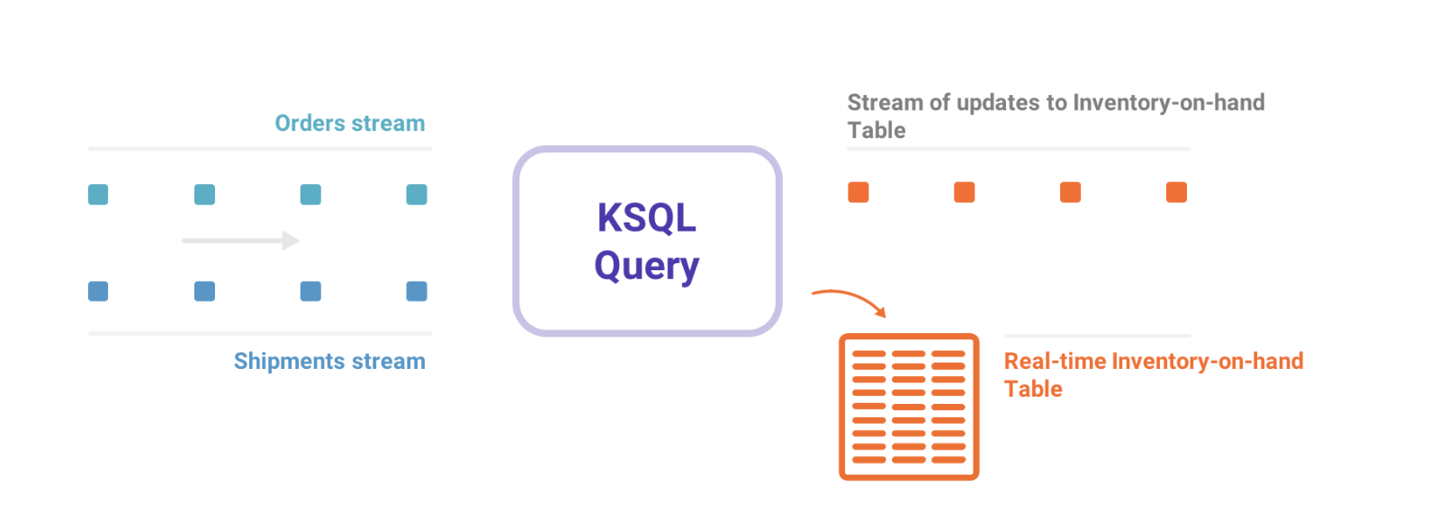
KSQL Summary
Usage:
Application Correctness (ex. welcome email)
Custom monitoring
“Joining” data from various topics

Slide 28
Not all data is streaming data!
Kafka Streaming is an excellent option for real time data
What if you do have streaming data but your architecture doesn’t support it?
Building a streaming architecture from ground up can be expensive.
So far we’ve seen Kafka’s capability to transform data in the ETL process
To extract and load data from existing sources, we can use Kafka Connect

Slide 29
KAFKA CONNECT
Open source framework on top of Core Apache Kafka
Introduced in Nov 2015 when Kafka 0.9.x was released
Import from any external source – MySQL, HDFS etc using Source Connector
Export from cluster to external “sink” using Sink Connector
Helps move large collections of data into and out of Kafka
It collects data from sources into topics (yes, same topics from streaming)

Slide 30
Kafka Summary
Kafka provides services for various data processing needs
You can use Kafka to:
process streaming data
Import data from existing sources
Perform real time queries on streaming data
Different services let you have complete control over the ETL cycle

Slide 31
Questions

Slide 32
Refrences
https://kafka.apache.org/intro
http://cloudurable.com/blog/kafka-architecture/index.html
https://www.cloudkarafka.com/blog/2016-11-30-part1-kafka-for-beginners-what-is-apache-kafka.html
https://medium.com/@shaaslam/installing-apache-kafka-on-windows-495f6f2fd3c8
https://jaceklaskowski.gitbooks.io/apache-kafka/kafka-brokers.html
https://sookocheff.com/post/kafka/kafka-in-a-nutshell/
https://www.confluent.io/blog/ksql-open-source-streaming-sql-for-apache-kafka/
https://www.cloudkarafka.com/blog/2018-07-04-cloudkarafka_what_is_zookeeper.html
https://simplydistributed.wordpress.com/2016/12/13/kafka-partitioning/
https://docs.confluent.io/current/ksql/docs/index.html

